Slide 1
Freight Planning in Southeast Michigan
Ian Thompson, Transportation Planner
Southeast Michigan Council of Governments

Slide 2
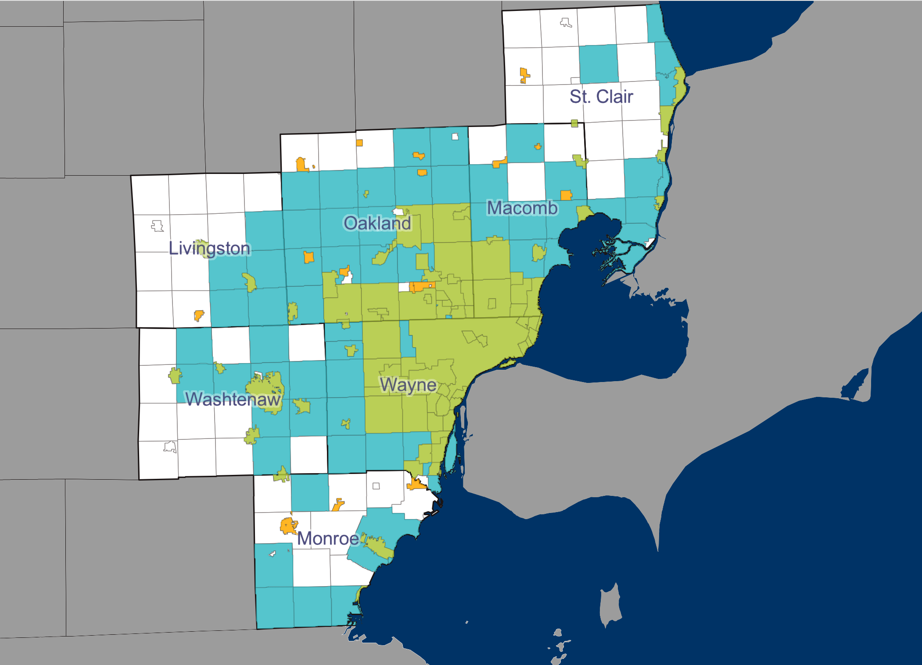
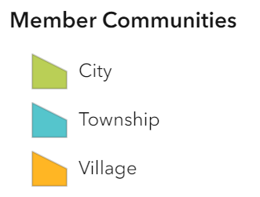
About SEMCOG
Southeast Michigan Council of Governments
Formed in 1968
Governed by a 48-member Executive Committee
7 Counties; 93 Cities; 24 Villages; 115 Townships
4.75 million people
Bordered by Canada, Ohio, & Great Lakes
Notes:
Dedicating Metropolitan Planning Organization (MPO) for 7 Counties in Southeast Michigan. Serving 4.75 million people (almost half of the state of Michigan's population). We are a council of governments – we are governed by a 48-member executive committee (made up of elected officials in our region).
Nationally, people recognize and know Detroit & Metro Detroit. We are large region made up of both Urban and Rural communities.
We share an 87-mile border with SW Ontario, Great Lakes/St. Lawrence Seaway, Ohio.

Slide 3
Regional Transportation Plan (RTP)
Notes:
Like all MPOs in the states, our Long-Range Plan is federally required document showing how the region plans to invest federal, state, and local transportation dollars.
We develop additional plans that feed into our Regional Transportation Plan (RTP) --> Vision 2050.
We are developing a Freight Plan for Southeast Michigan. It is not federally required, but we believe it’s increasingly important that freight considerations are integrated into policy and planning. Because the movement of goods is important to our economy, businesses, and consumers.

Slide 4
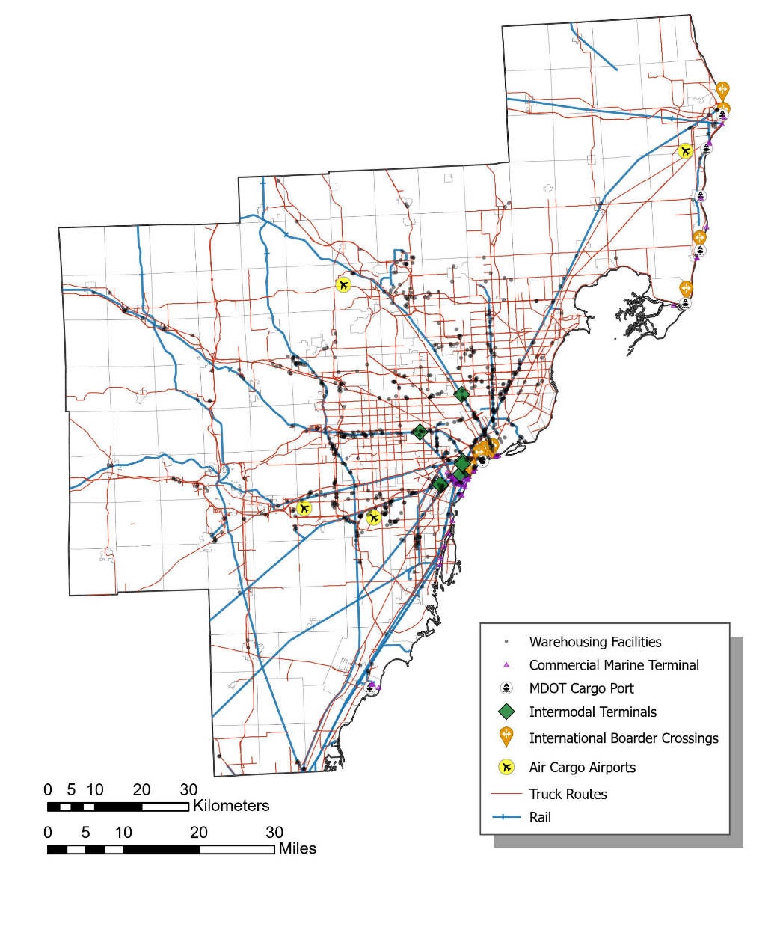
Freight System Southeast Michigan
Southeast Michigan Freight Network Map (Draft)
Truck Routes (4,000 miles of all-season truck routes)
4 Class I Railroads (900 miles of rail lines)
Ports & Commercial Marine Terminals
6 Intermodal Terminals
23 System Airports (4 Cargo Airports)
Over 750 Warehousing Facilities
Pipelines
7 International Border Crossings
Freight Value in SEMCOG Region (2022)
$457 billion dollars
204 million tons
Notes:
High-level view of our freight system and the physical Infrastructure that makes up that freight network.
List the modes on the screen.
The border crossings are key asset for the movement of goods and access to labor, and serve as the gateway to the rest of the U.S.
The SEMCOG region is well served by every mode of freight transportation and is a major national freight corridor - A significant amount of goods moves in/out/through the SEMCOG region each year. In 2022, 204 million tons of goods at a value of $457 Billion dollars moved in/out/through the SEMCOG region

Slide 5
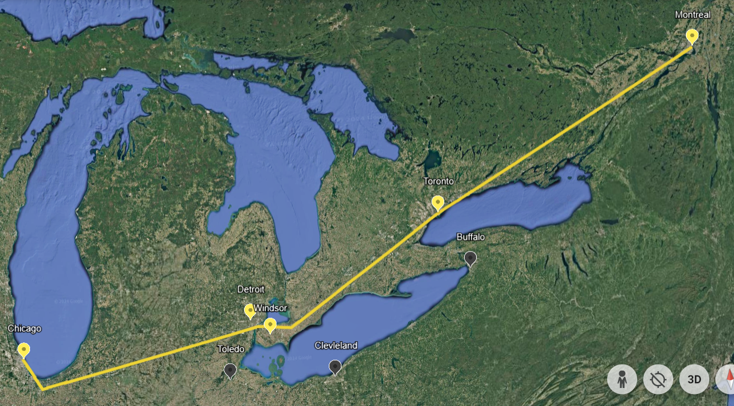
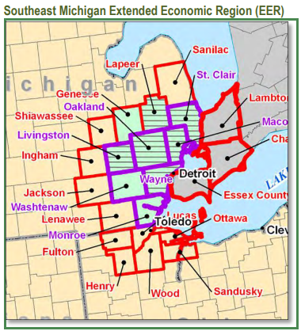
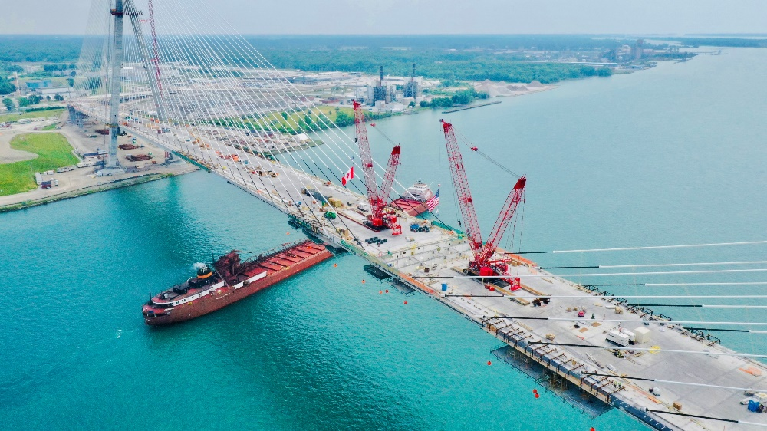
Freight & International Trade
Montreal-Toronto-Windsor-Detroit-Chicago corridor
Border Crossings
87-mile border with Southwest Ontario
7 international border crossings
3 auto/truck crossings
2 International Rail Crossings
2 Ferry services
Marine Ports -> Great Lakes/St. Lawrence Seaway
Gordie Howe Internation Bridge
36% of U.S.-Canada border trade crosses through Southeast Michigan ports of entry
Notes:
Southeast Michigan plays a vital role this critical trade corridor that link both freight and passenger movement between the U.S. and Canada. Given our geographical position along with the existing physical infrastructure – our region serves as a key gateway for trade with Canada, the Great Lakes/St. Lawrence Seaway, Chicago, the Midwest, Mexico, and beyond.
We share 87-mile border with Southwest Ontario – 7 International crossings. 3 primary auto/truck crossings (AMB, BWB, DWT) and soon to be 4 with the opening of the GHIB which is scheduled for fall of this year. Each border crossing plays a vital, complementary role that is important to our economic and social relationships. It’s not just goods movements – its people coming over the border for entertainment, getting together with family, going to work.
US and Canada share the world’s largest and most comprehensive trading partnership.
The state of Michigan has been Canada’s most important trading partner. A significant amount of U.S.-Canada border trade crosses through Southeast Michigan ports of entry. Although our region is 7 counties in SE Michigan, we operate as part of an extended economic region with the nearby counties in Canada, Michigan, and Ohio.

Slide 6
Freight Projections in Southeast Michigan
2022
2050
2022
2050
204 million tons
263 million tons
$457 billion
$702 billion
Notes:
These charts show a modal breakdown of freight moved in, out, and within our region in 2022 and forecasted projections for those modes out to 2050. We anticipate an overall increase in both tonnage and value.
All modes play their own role in the types of goods that are moved and an efficient cost travel times and overall resilience of supply chains.
Trucking handles the major freight by tonnage and value and like national trends – the amount of freight moved by truck is anticipated to increase. This is something to consider when we think about the impacts truck parking, congestion, GHG emission, and safety on roadways.

Slide 7
Freight Related Industries & Jobs
Job Sector | Number of Jobs
Nat Res & Construction | 139,452
Manufacturing | 284,764
Wholesale Trade | 101,294
Transportation, Warehousing & Utilities | 146,550
Retail Trade | 271,928
Info. & Fin. Activities | 339,886
Prof./Tech. Serv. & Corp HQ | 355,396
Admin, Supp., & Waste Serv. | 193,512
Education Services | 196,508
Healthcare Services | 395,637
Leisure and Hospitality | 269,180
Other Services | 170,609
Public Administration | 97,053
Total Jobs in SEMCOG Region | 2,961,769
Total Jobs in SEMCOG Region (2019) = 2,961,769
Freight-Related Jobs (2019) = 672,060
Notes:
Freight & Cross-Border Workforce Impact in Southeast Michigan
• ~25% of regional jobs depend on the freight industry.
• Manufacturing is heavily tied to imports/exports, most impacted to tariffs.
• 132 Canadian-owned firms were active locally as of 2009.
Border Crossings Support More Than Freight Jobs
• Healthcare is the region’s largest employment sector. During the 2008–09 recession, there was shortage of qualified health professionals and actively recruited nurses from Canada. Smooth border access is essential for maintaining this workforce.

Slide 8
Michigan Top Trading Partners Canada and Mexico
Imports = $173 Billion
Exports = $62 Billion
Source: International Trade Administration; analysis by SEMCOG.
Notes:
Canada and Mexico are two of Michigan largest trading partners. This slide shows how much our economy is interdependent on trade with Canada and Mexico.
Michigan’s top trading partners
Roughly 38% of Michigan exports are to Canada
28% of the state’s imports are from Canada
(Michigan imports almost three times as much in value as it exports.) The top commodities that we import, and export are vehicles and automotive parts. The automotive industry is important to our region’s economy. Tariffs on Canada and Mexico will have a disproportionately negative effect on Southeast Michigan.
The value of goods moving through the Detroit-Windsor gateway is roughly $350 million a day.
The costs of tariffs are going to have a significant impact and are carried over for local governments too: Reduced economic development investment. Higher costs on materials for infrastructure and capital improvements.

Slide 9
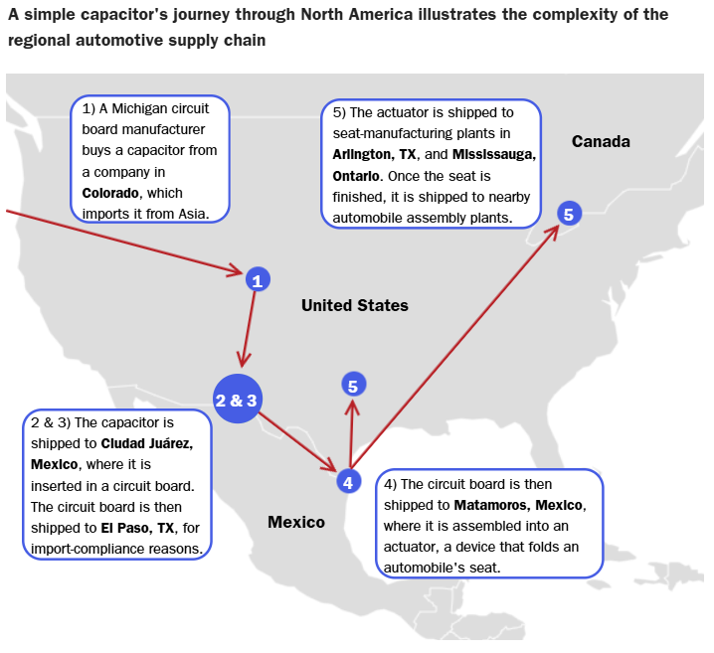
One auto component’s journey through the North American supply chain
Source: The Cato Institute adaptation from Thomas Black, Jeremy Scott Diamond and Dave Merrill, "One Tiny Widget’s Dizzying Journey
Through the US, Mexico and Canada," Bloomberg, updated May 31, 2019.
Notes:
The automotive industry is important to jobs and the economy in our region. This slide shows how a single capacitor crosses the border 5 times before finding its way into an assembled vehicle.
Consider that the average vehicle has 30,000 parts, and you can imagine how costly tariffs become for the automotive sector.

Slide 10
Border Crossings: Commercial Vehicles
Notes:
This graph is showing commercial vehicle crossings since 2013 at AMB & BWB, which are two of the highest passenger and commercial vehicle crossings between US and Canada.
Historically, the AMB has been the busiest international crossing between US & CA followed by the BWB.
Like most international crossings there was a decline in truck crossings in 2020 but remained relatively stable compared to the drastic decline in passenger traffic across our borders in 2020.
In 2024, we’ve started to see a shift in truck traffic between the AMB & BWB.
Observing a decline in AMB crossings and in increase in BWB crossings.
As of March, of this year, the BWB has around 30,000 more truck crossings than the AMP

Slide 11
International Rail Crossings & Marine Ports
Southeast Michigan International Rail & Marine Ports
Internation Rail Crossings
Paul M. Tellier Tunnel, double-stack clearance
Detroit River Rail Tunnel, single stack clearance
Positive momentum to re-establish passenger rail service along Detroit River Rail Tunnel
Cargo Ports
Port of Detroit - handles over half of Southeast Michigan's marine cargo tons.
Port of Monroe - direct rail Class 1 rail access, slated to be first container port in Michigan
Notes:
There are two international rail crossings in our region. Paul M. Tellier Tunnel – which connects Sarnia, Ontario & Port Huron, MI. Double-stacked clearance moving freight traffic. Detroit River Rail Tunnel – which connects Windsor, Ontario and Detroit, MI moving single-stacked clearance moving freight. Both tunnels carry finished automobiles and mixed freight, but not passenger traffic. {Fill in wording about Via rail, Amtrak Connections}
SEMCOG has been working with federal & provincial governments along with Amtrak & Via rail and there is a lot of positive momentum to re-establish passenger rail service along Detroit River Rail Tunnel. Ford has also been a partner in that - renovated Michigan Central Station and it officially opened last summer.

Slide 12
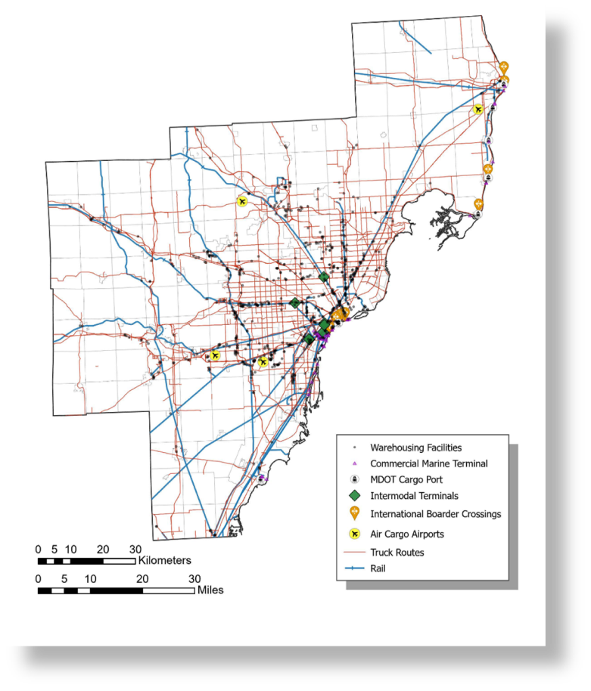
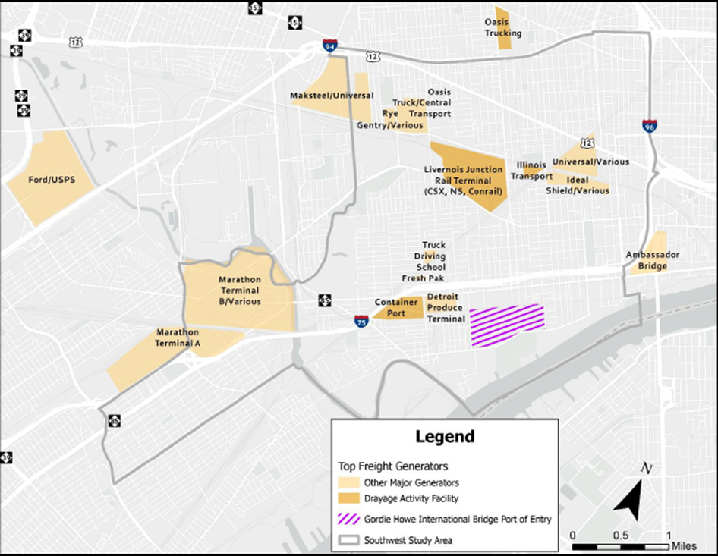
Southwest Detroit: major generators of freight
Southeast Michigan Freight Network Map (Draft)
Notes:
Importance of Southwest Detroit - Freight and Border Movement
Historically SW Detroit has long been a hub for trade, and industry—because of its location to the border, the St. Laurence River – currently you have the convergence of highways and rail tunnel that link the Midwest and Canada with dense & heavy industry
Crossings: Ambassador Bridge, Gordie Howe International Bridge (under construction), and the Detroit-Windsor Rail Tunnel
Industry: Marathon Petroleum, Detroit’s auto manufacturing footprint, the DIFT/Livernois Junction rail terminal, and Industries supporting drayage system
Community impacts long-standing: Heavy truck traffic, road and pedestrian safety concerns, Air quality and noise issues, fugitive dust, and stormwater runoff, Structural damage to homes from vibration and traffic.
SW Detroit
Vibrant, stable, and dense communities in Detroit
strong social networks
strong cultural traditions
strong community-building organizations
thriving local retail and business community
relatively dense population of children

Slide 13
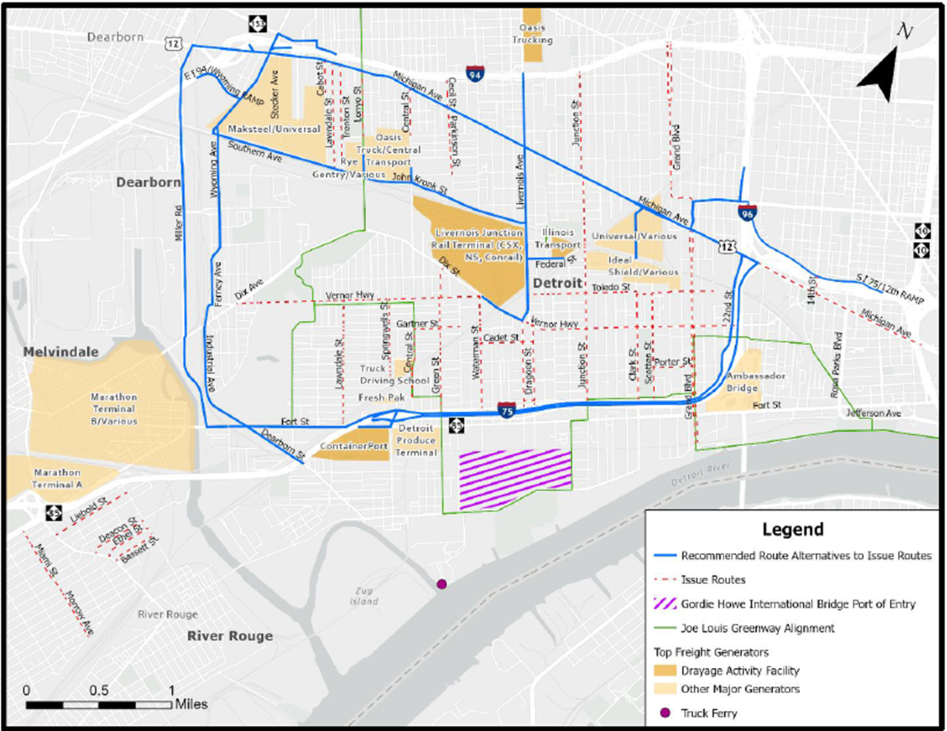
Southwest Detroit Truck Management
Southeast Michigan Freight Network Map (Draft)
Notes:
The City of Detroit, often with strong community advocacy, has taken steps to address these challenges.
• Southwest Trucks Study – mitigate truck traffic around residential streets.
Pave their section of Livernois/Junction Terminal
• EPA - Clean Ports for Electric Drayage Trucks ($75M)
• FRA Rail Funding for Norfolk Southern Entrance reconfiguration, screening, paving, and modernization ($60M)
• Applying for design Rail crossing elimination and viaduct reconstruction at Lonyo (Joe Louis Greenway) & Central ($6M)
SEMCOG has been a partner with City of Detroit in supporting their efforts.

Slide 14
Southeast Michigan Freight Plan
Regional Freight Issues
FREIGHT RESILIENCY
Key Freight Plan Activities
Existing Conditions Analysis
Freight Commodity Flows Analysis
Freight Resiliency Assessment
Freight Community Impacts Analysis
Freight Activity Centers Identification
Truck Parking Analysis
COMMUNITY IMPACTS
EMERGING TRENDS
TRUCK PARKING
Notes:
Wrap up with – we are in the beginning states of developing a fright plan. We’ve heard from stakeholders in our region about freight-related challenges. The importance of trade, reliable goods movement, resiliency of the freight system, emerging trends that we see - plan for these challenges and guide investment decisions to ensure safe and efficient movement of goods while maintaining a careful balance between community and freight needs.
Disruptions to the movement of goods from natural disasters, flooding, supply chain issues. Impacts on communities are disproportionately affected by freight activity.
Emerging trends like the rise in e-commerce, drone usage, CAVs, and the growing need for truck parking.
Truck Parking – lack of available truck parking has been a regional and national issue

Slide 15
Thank You
Ian Thompson
Transportation Planner
Southeast Michigan Council of Governments
thompson@semcog.org
SEMCOG Freight Hub Website

